Slide 1
Taxes 2017
Financial Management

Slide 2
Property Taxes
Imposed by townships, cities, counties, states, or school districts on the owner of any type of real property
Used to raise funds for such services as police and fire protection, roads parks school districts, or street repairs
This tax is levied (ordered to be paid) quarterly, semiannually or annually
Clare County is semiannually (Summer and Winter)
Property taxes are calculated on a value
Either Millage (Mills) or Tax Rate (Michigan uses Mills and converts them to tax rate)
Value is the amount listed in tax records
It’s the assessed value (taxed on assessed value) verses the market value (not taxed on market value)
If you own property, you will pay property tax based on the value of that property.

Slide 3
Figure the tax
Mills
25 mills are assessed on all property
25/$1,000 = .025
.025 x $50,000(assessed value) = $1,250

Slide 4
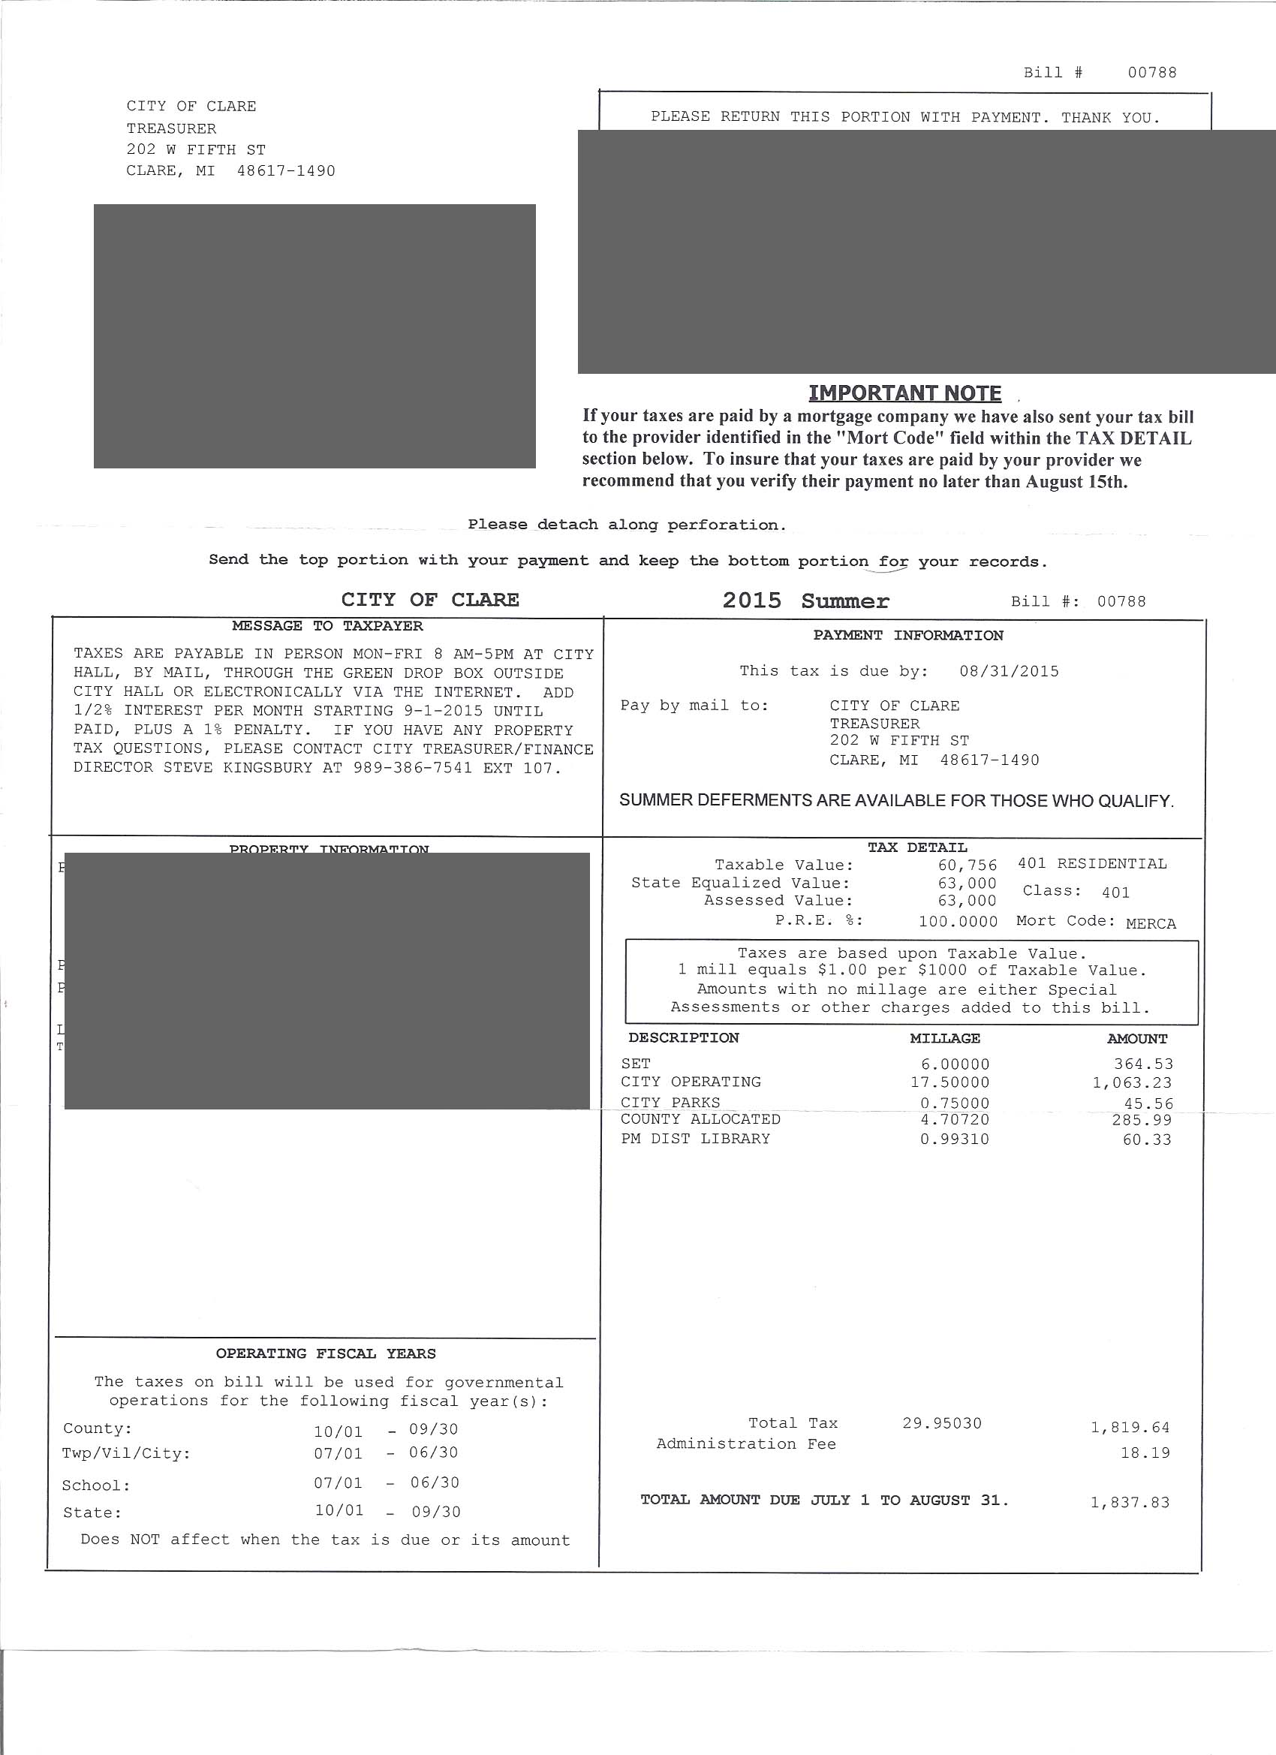
Examples of Tax Bills

Slide 5
Taxable Value on Property: $50,000
Tax Description | Millage (Mills) | Converted to Tax Rate (mills/$1,000) | Amount of Tax (Tax Rate * Taxable Value)
Country Transit | 0.30000 | .0003 | $18.22
County Seniors | 0.75000
RESD Operating | 0.40750
RESD Special Education | 1.63100
Mid Michigan College | 1.22320
City Operating | 17.50000
County allocated | 4.70720
City Parks | 0.75000
District Library | 0.99310
Complete Section Two of Worksheet

Slide 6
Federal Unemployment Tax – Businesses pay
Federal – collected by the IRS to fund Unemployment Insurance and Job service programs in all states
FUTA – rate set by Congress
6.2% on the first $7,000

Slide 7
State Unemployment Tax – Businesses pay
State – collected by state government to fund state workforce agencies and benefits to eligible unemployed workers
SUTA – rates vary by state
Assume 3% on first $9,000
Cleary Catering had a total wages of $219,300 for the first quarter. All wages were subject to the state unemployment tax of 3% because no employee had earned the maximum of $9,000 by the end of the quarter. Find the amount of state unemployment tax owed.
$219,300 x 3% (.03) = $6,579

Slide 8
Complete State Unemployment Worksheet

Slide 9
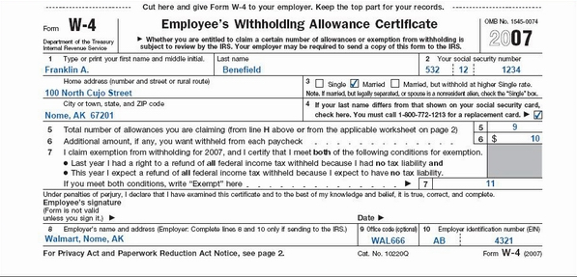
New Employee Form – (W-4)

Slide 10
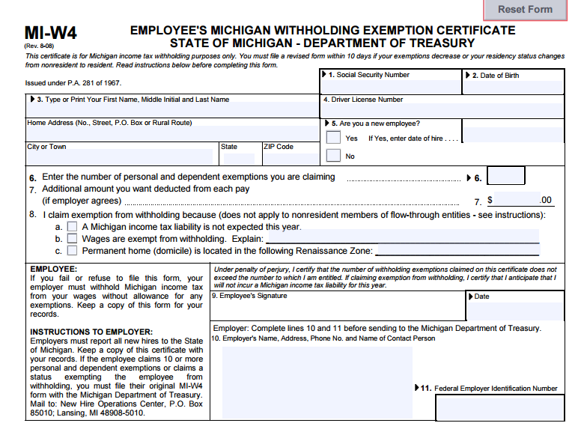
New Employee Form (MI-W4)

Slide 11
Income – (Form W-2)

Slide 12
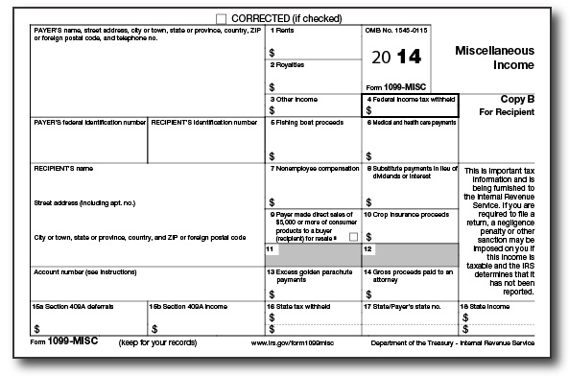
Miscellaneous Income (Form 1099)
Added income
Contract labor
Interest earned

Slide 13
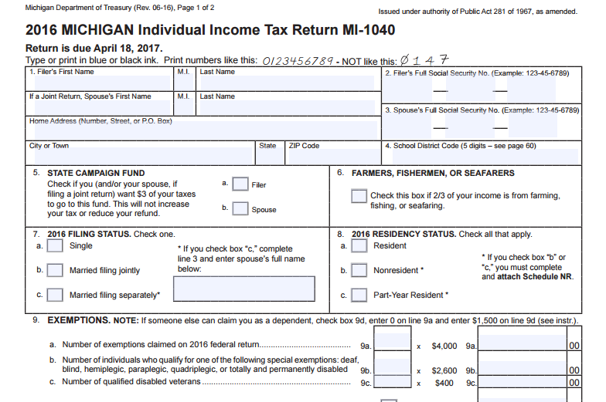
State Withholding Tax Form (MI-1040)

Slide 14
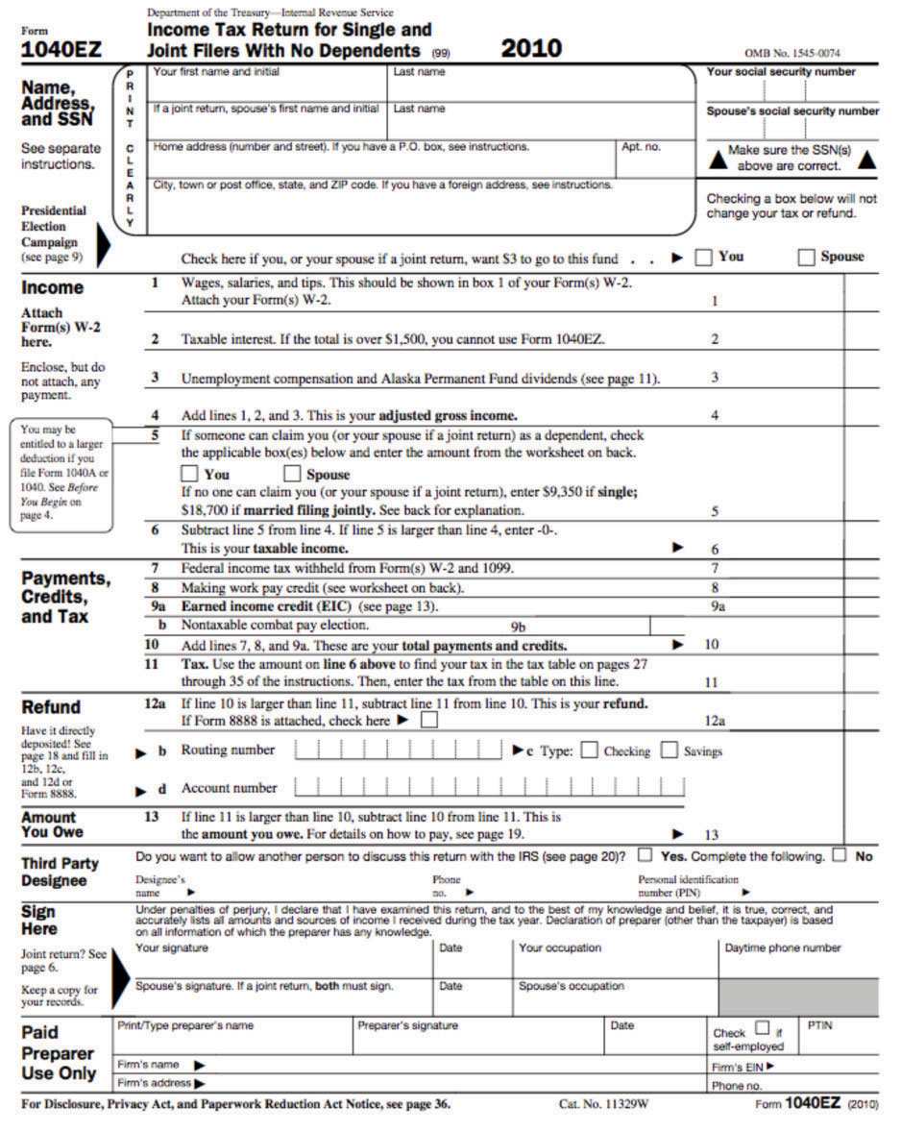
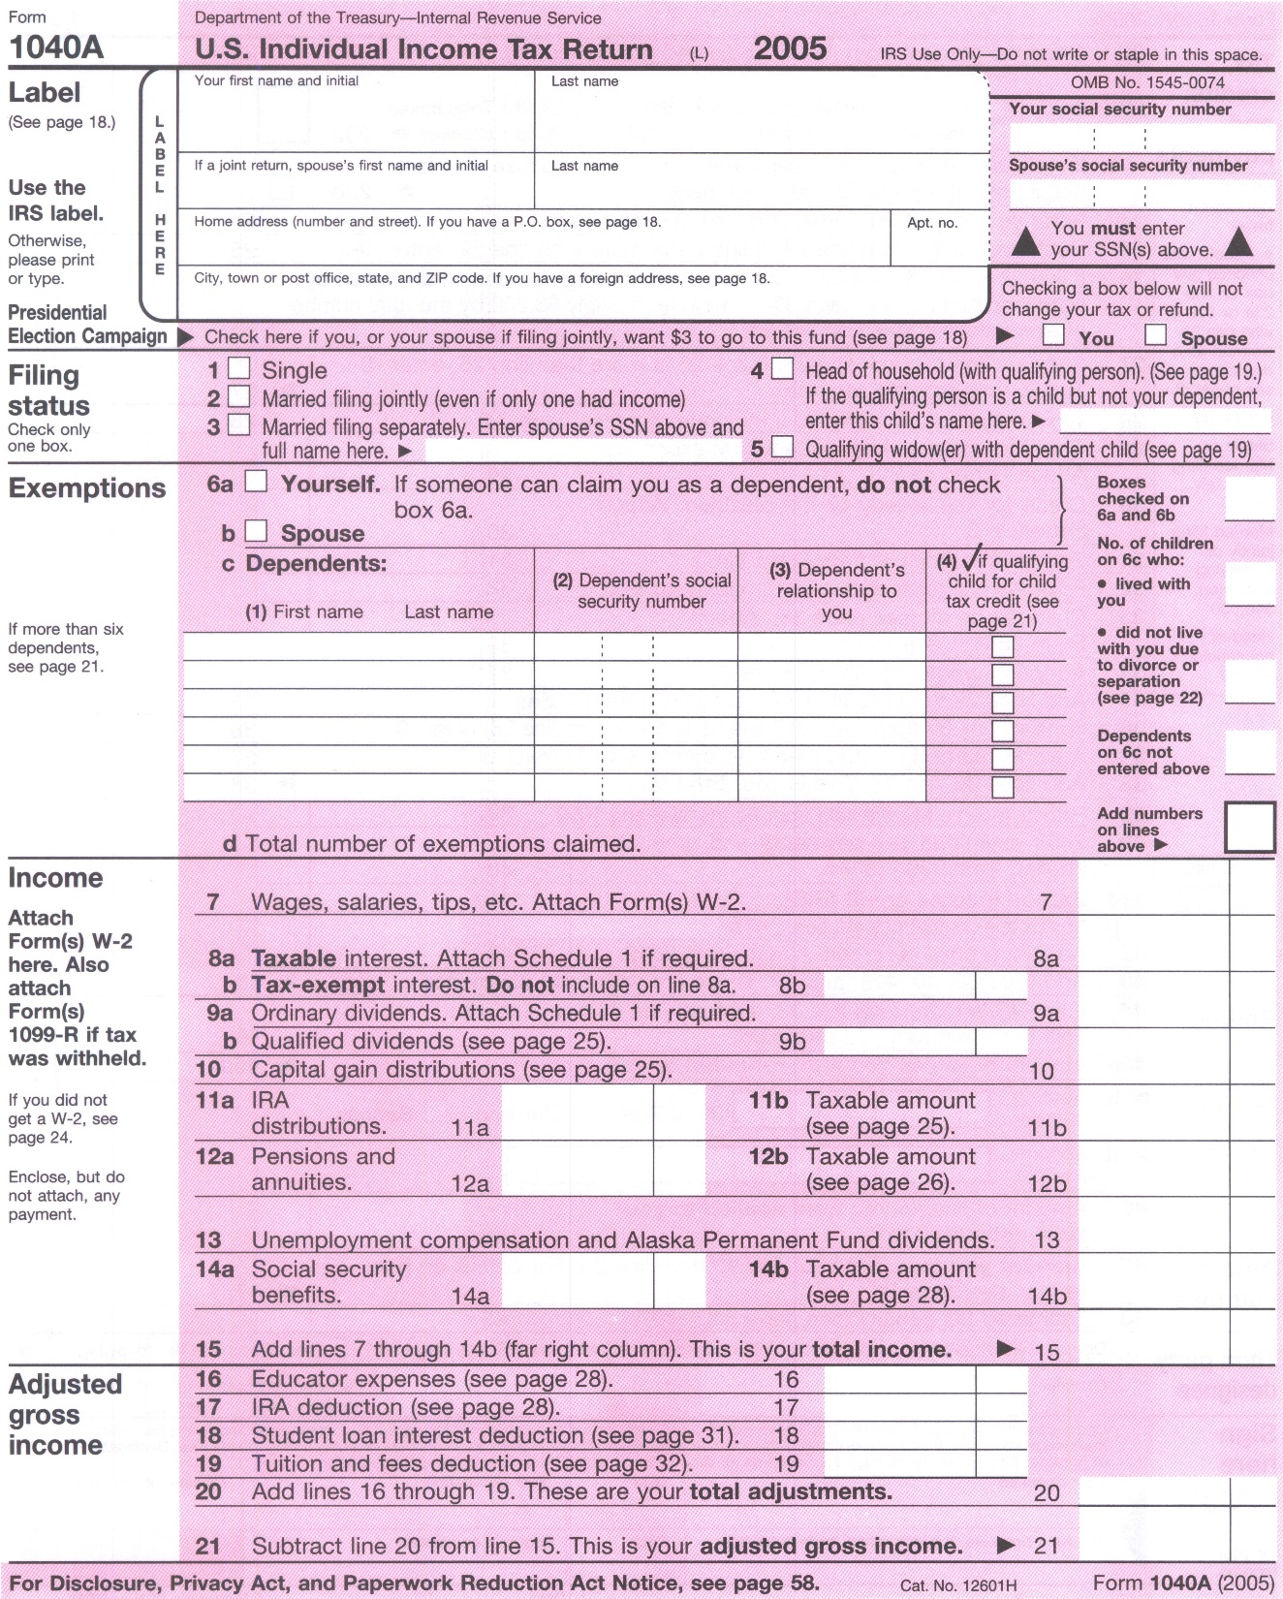
Federal Withholding Tax Forms

Slide 15
Prepare Tax Return - manually or electronically
Benefits of Electronic Preparation
Increased accuracy
Easy
Prepare state and federal tax returns at the same time
Tax Return Transmission
Mail
Electronic filing (e-file) option
Benefits of Electronic Transmission
Direct Deposit (receive quickly)
Electronic funds withdrawal for payment
Secure
Paperless

Slide 16
Do your taxes!

Slide 17
1st Form (1040EZ and MI-1040)
Calculate Molly Merillat’s income tax and the amount due or the amount of her refund. Molly is single and a student with only part-time wages and a small amount of interest income. Note on line 5, because Molly is single, she combines the standard deduction of $10,350.
Wages: $15,550
Taxable Interest: $780
Federal Income Tax Withheld: $1,005
State Income Tax Withheld: $56

Slide 18
2nd Form (1040A and MI-1040)
Gavin Showalter is single.
Wages: $20,950
Taxable Income: $752
IRA Deduction: $2,000
Federal Income Tax Withheld: $950
State Income Tax Withheld: $345

Slide 19
Quiz!

Slide 20
123-45-6789
38-1235650
10747.00
1309.00
Cleary Catering
123 S. Front Street
Happy Street, MI 48898
10747.00
666.00
10747.00
156.00
Your Name
100 Front Street
Happy Street, MI 48898
MI
38-1235650
10747.00
430.00

Slide 21
123-45-6789
38-1235650
5640.00
422.00
Cleary Catering
123 S. Front Street
Happy Street, MI 48898
5640.00
350.00
5640.00
82.00
Your Name
100 Front Street
Happy Street, MI 48898
MI
38-1235650
5640.00
115.00

Slide 22
123-45-6789
38-1235650
15000.00
500.00
Cleary Catering
123 S. Front Street
Happy Street, MI 48898
15000.00
930.00
15000.00
215.00
Your Name
100 Front Street
Happy Street, MI 48898
MI
38-1235650
15000.00
575.00

